Slide 1
TGC Annual Meeting
Zoom
Monday October 14th 2024

Slide 2
Fall Clinic
November 9 - 10
Powerhouse Gymnastics (San Antonio)
Information sessions on Saturday 4pm
How to construct a routine / judge presentation
How to host a meet
How to attend a meet
TGC Dinner/Social TBA
Workout on Sunday morning

Slide 3
Agenda
Approve 2023 Minutes
Roll Call
TGC Background
Current Objectives/Goals
Last Meeting
Constitution/Rules Discussion
2025 Meet Schedule
2025 TGC Shirts
Elections

Slide 4
Roll Call
Roll Call
Has anything major changed for your club this year?
Survey Results

Slide 5
TGC History
1979: TGCCC Founded, though clubs and competition existed beforehand
Teams began attending NAIGC nationals in early 90’s
2006(?): Constitution written
2012: Began collecting income
2016: Board expanded
2018: Registration and Scoring System
2019: Constitution cleanup
2024: Attained 501c3 status
Notes:
Andrew

Slide 6
Current Objectives
Education
-Alliance with Judging Organizations
-Clinics/ Judging Courses
2. Outreach
-New Clubs
-Visibility to JO Clubs/High School Programs
-Marketing/Brand Development

Slide 7
Current Objectives
3. Facilitating Competition
-Streamline Meet Registrations
-Streamline Competition Structure and Rules
-Speed up meets and accommodate growth
4. Operations
-Fundraising (we’re a 5013c now!)
-Collecting payments via website*
Notes:
* we would still prefer direct deposits or methods that don't have transaction fees
also the website meet pages should be faster, still can have a little more to do

Slide 8
Proposed Constitutional Changes
Add Level Diamond and remove Level 8
Add additional MAG Level
Two year term for alumni rep
Requiring physical meet awards for all places awarded
Add TGC approval for post-finalization roster changes to guard against damaging cumulative total changes
Rewording constitution language to be more clear
Minor text revisions

Slide 9
Proposed Constitutional Changes
Responsibilities of Event Attendees
It is the responsibility of the Club or individual open athlete to register on time and pay event fees.
Attendees must register three weeks prior to the event to avoid being charged a late fee. After three weeks prior, a $10 per attendee late fee will be imposed, and any athletes registered at that time cannot be removed and will incur the competition fee. One week prior to the event, registration is closed, and additional entries will only be allowed at the discretion of the event Host and TGC board.
For all TGC meets except Conference Championships, there will be an entry fee of $15.00 per individual competitor and an additional $10.00 per team. Participants’ on-time rosters are due three weeks prior to the competition, and meet fees will be charged based upon participants’ final rosters at the time of the final registration deadline, plus any changes approved by the meet host and TGC board after the deadline."and entry fees will be charged based on this roster.
For the Conference Championships, $20.00 per individual competitor will be charged by the host school. An additional $20.00 per team will be charged for those Clubs entering the team competition. All entry fees will be paid to the event Host unless otherwise directed by the event Director. The TGC will charge an additional $10 per gymnast based on the rosters at the time of finalization. submitted three weeks prior to the competition.
If after the registration deadline, an individual open athlete or member(s) of a Club are no longer able to compete, it is the responsibility of the individual open athlete or Club to contact the event Host.
An athlete may be added or substituted in the team registration after the registration deadline at the discretion of the event Host and TGC Board.
An athlete can’t be removed after the late deadline without the approval of the TGC board.

Slide 10
Proposed Constitutional Changes
Team Awards:
If there are less than or equal to three teams eligible for an award, the Meet Host has the discretion to determine how many teams to award, but must at least award the top team.
If there are more than three teams eligible for an award, the Meet Host will award the top three teams. All awarded teams and athletes should receive a physical award if offered.
The voting representative for the combined membership of open athletes will be determined by a majority vote of open athletes who competed and paid applicable fees during the most recent competition season. The nomination period for the voting representative will commence four weeks prior to the Annual Meeting and last for one week. Immediately following the nomination period, there will be a one week voting period via an online poll, and the voting representative for the combined membership of open athletes will be determined two weeks prior to the Annual Meeting. The term will last until one of the following criteria are met:
the position is vacant
the board removes the representative
there are other interested candidates between the previous competition season and next annual meeting, provided the current representative has served for at least one competition season

Slide 11
Proposed Constitutional Changes
Minor Text Approvals
The Board of Directors shall be composed comprised of five voting positions (President, Vice President, Secretary/Treasurer, and two Directors) plus an Executive Director.
Immediately following confirmation of the meet schedule, the Meet Host should request judges. If the host fails to request judges at least eight weeks prior to competition, the TGC has the right to revoke the privilege to use TGC resources for that competition. If judges have not been assigned four weeks prior to the competition, it is the responsibility of the Meet Host to follow up with the assigner. After judges have been assigned, it is the responsibility of the Meet Host to contact the assigned judges with information about the competition. See Appendix B for guidance related to requesting and obtaining judges for TGC competitions.

Slide 12
Any New Rules?
Revisit discussion from summer meeting on ideas to make meets run faster:
Omitting a level
Further limiting competitors
Person designated to check that teams are moving along correctly
Limiting number of teams
Have MAG compete Floor and Vault between women’s sessions (~1-1.5 hours)
Notes:
mention new alum listserv

Slide 13
Major Rule Reminders
Review Constitution with emphasis on:
(Caveat of any proposed changes just approved)
Article 6.4:
i) Attendees must register three weeks prior to the competition to avoid being charged a late fee. After three weeks prior, a $10 per competitor late fee will be imposed. One week prior to the competition, registration is closed, and additional entries will only be allowed at the discretion of the Meet Host.
ii) For all TGC meets except Conference Championships, there will be an entry fee of $15.00 per individual competitor and an additional $15.00 per team. Participants’ rosters are due three weeks prior to the competition, and entry fees will be charged based on this roster.
iii) For the Conference Championships, $20.00 per individual competitor will be charged by the host school. An additional $20.00 per team will be charged for those Clubs entering the team competition. All entry fees will be paid to the Meet Host unless otherwise directed by the Meet Director. The TGC will charge an additional $10 per gymnast based on the rosters submitted three weeks prior to the competition.
iv) If after the registration deadline, an individual open athlete or member(s) of a Club are no longer able to compete, it is the responsibility of the individual open athlete or Club to contact the Meet Host.
Article 6.3:
The Meet Host must contact teams four weeks prior to the competition concerning meet organization (including specific competitor limitations that will be imposed). Any exceptions or modifications to these rules may be permitted with the agreement of all teams concerned. If the Meet Host fails to contact teams at least four weeks prior to the competition, late fees will be waived for that competition.
Notes:
mention new alum listserv

Slide 14
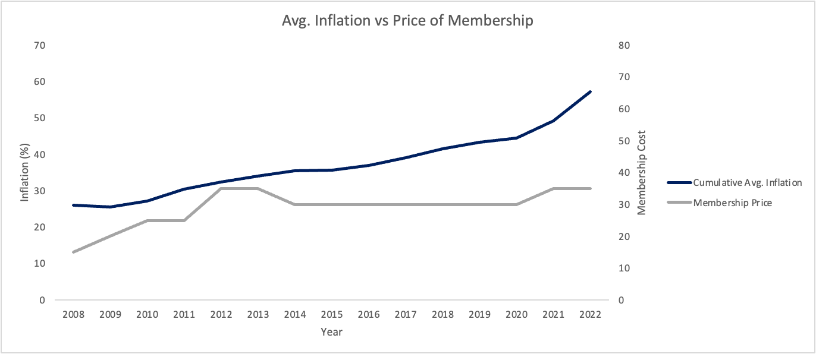
NAIGC Updates
Notes:
mention new alum listserv

Slide 15
Outstanding Last Season Payments
 | Shirts | Memb Fee
Texas Tech | $ 180.00 | $ 220.00
Baylor University | $ 90.00 | $ 70.00
U Houston | $ 105.00 | $ 50.00
OGC | n/a | $ 110.00

Slide 16
Proposed 2023-2024 Budget
Domain name and website: -$70
TGC Shirts: -$2000 + $2300
Fall Clinic: +$360 - $650
TGC fees: +$800
Nonprofit Application: -$300

Slide 17
Actual 2023-2024 Budget
Domain name and website: -$79.94
TGC Shirts: -$1798.41 + $2205* = $406.59
Annual membership fee: $1710
fall clinic: -$160
*once we collect outstanding payments. Also design was cheaper this year.

Slide 18
Proposed 2024-2025 Budget
Domain name and website: -$80
TGC Shirts: roughly break even
Fall Clinic: roughly break even
TGC fees: ~+1500
Currently we have ~$6000 once we get outstanding payments
Need a buffer around $2k for shirts
In theory most annual profit would cover subsidizing clinic
Your predecessors have opted to hold some funds for a rainy day (i.e. if nobody can host a meet we help rent a gym/equipment)

Slide 19
Questions?
Any questions about the presentation so far?
10min break / intermission
Next up:
2025 Meet Schedule
Shirt Designs
TGC Board Elections

Slide 20
Scheduling Constraints
Spring Break
Mar 10-14: Baylor, A&M, Houston, UTA. TxSt, UNT
Mar 17-21: UT, TCU, UTD, Tech, OU
Other big meets to avoid:
Jan 23-26: HNI
Jan 30 - Feb 2: Biles Invitational
Feb 13-16 & 21-23: Metroplex
Feb 20-23: WOGA Classic
Meet Schedule
Jan 17 -19: OGC (MAG only)
Feb 1-2: UT
Feb 8-9: Tech
Tentative Feb 15 or 16: SCL/Baylor (one day only…exact day TBD)
March 1: UH
Tentative March 8: Baylor (WAG only)
March 29: A&M
April 2-5: NAIGC Nationals
Notes:
For TGC Hosts:
Everyone said both open & collegiate to their respective offered levels
Everyone said modified capital cup (warm up each event before competing it)

Slide 21
2025 Shirts
We need a design by December 31
Dri fit, cotton or other?
Do we want to try something else like tank tops?

Slide 22
Anything else?
Before we open the floor to elections

Slide 23
Elections
1. President
2. Vice President
3. Secretary/Treasurer
4. Directors (2)
5. Executive Director
Notes:
Describe Positions, (college students spiel),Take Nominees for Each Position, Vote For Each

Slide 24
Reminders for club reps
Make sure your officers are subscribed to TGC email list and are in the discord
Make sure your officers are subscribed to NAIGC announcement list
you can remind gymnasts too as rules and nationals logistics are announced via that list
Optionally your officers can be in the NAIGC discussion google group
If you have competing alumni/adults make sure they are subscribed to the alumni email list.
Poll your team if anyone is interested in making a shirt design
Remind your team and the world to follow TGC social media!!!
Also follow each other on social media. tgcgymnastics.com/teams

