Slide 1









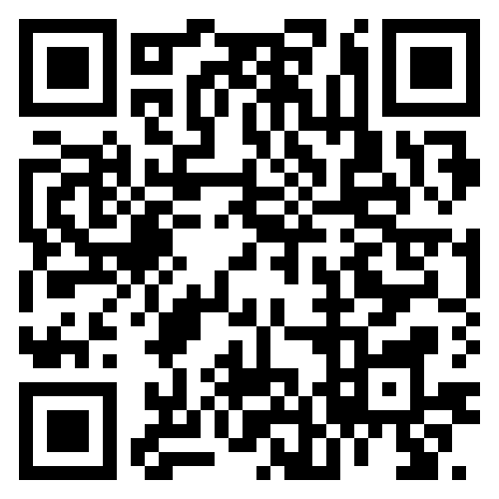
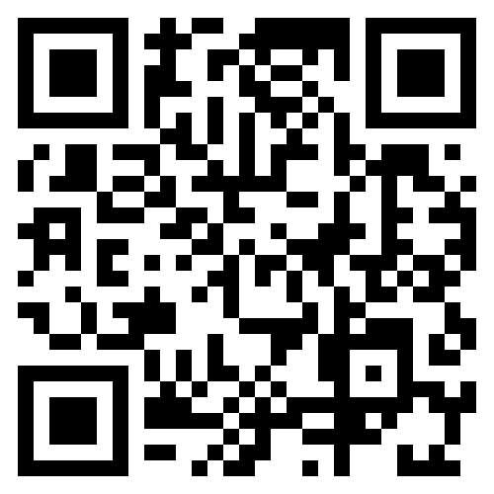







TGC Annual Meeting
Seguin
Saturday October 25th 2025
TGC Discord NAIGC Email Announcement List

Slide 2
Fall Clinic
Today!
11:30am: Annual Meeting
2pm: How to host a meet
3pm: Information sessions with judges
  How to construct a routine / judge presentation
5:30pm: How to attend a meet
6:00pm: Workout
TGC Dinner/Social TBA - Are teams staying?

Slide 3
Agenda
Approve 2024 Minutes
Roll Call
TGC Background
Current Objectives/Goals
Last Meeting
Constitution/Rules Discussion
2026 Meet Schedule
2026 TGC Shirts
Elections

Slide 4
Voting Procedures
A motion must be made for a vote, nomination, or request to table an item or move on
That motion must be seconded
Once seconded we can vote. We will vote to vote, if that passes then we will take the actual vote. The purpose of the first vote is to say “We’re ready to vote” vs “We want to discuss more”
We can vote by acclamation. This means a vote passes if nobody objects. If someone either objects or requests a full vote for the record then we will hold a full vote.

Slide 5
Roll Call
Roll Call
  Has anything major changed for your club this year?
Survey Results

Slide 6
TGC History
1979: TGCCC Founded, though clubs and competition existed beforehand
Teams began attending NAIGC nationals in early 90’s
2006(?): Constitution written
2012: Began collecting income
2016: Board expanded
2018: Registration and Scoring System
2019: Constitution cleanup
2024: Attained 501c3 status
Notes:
Andrew

Slide 7
Current Objectives
Education
-Alliance with Judging Organizations
-Clinics/ Judging Courses
2. Outreach
-New Clubs
-Visibility to JO Clubs/High School Programs
-Marketing/Brand Development

Slide 8
Current Objectives
3. Facilitating Competition
-Streamline Meet Registrations
-Streamline Competition Structure and Rules
-Speed up meets and accommodate growth
4. Operations
-Fundraising (we’re a 5013c now!)
-Collecting payments via website*

Slide 9
TGC & NAIGC
2 separate organizations
NAIGC membership fee is not the nationals fee!!
Student status differences
  in NAIGC students must be full time, in TGC any part time or full time is a student
  in NAIGC grad students can choose student or not, undergrads must be students
Nationals Award categories
  TGC has two categories: same-gender students and then everyone else
  Nationals has student men, student women, nonstudent men and nonstudent women for each MAG & WAG level.
  T&T and decathlon have no divisions
  There is a separate mixed team award for men+women combined
NAIGC has an extra set of skills in their code of points
Team differences
  TGC: collegiate team must be from same college
Notes:
Andrew

Slide 10
Proposed Constitutional Changes
Adjust meet deadlines in a way that makes host requirements actually possible
Raise team fee to $15

Slide 11
Rules about deadlines
Article 6.3:
The Meet Host must contact teams four weeks prior to the competition concerning meet organization (including specific competitor limitations that will be imposed). Any exceptions or modifications to these rules may be permitted with the agreement of all teams concerned. If the Meet Host fails to contact teams at least four weeks prior to the competition, late fees will be waived for that competition.
Article 6.4:
i) Attendees must register three weeks prior to the competition to avoid being charged a late fee. After three weeks prior, a $10 per competitor late fee will be imposed. One week prior to the competition, registration is closed, and additional entries will only be allowed at the discretion of the Meet Host.
ii) For all TGC meets except Conference Championships, there will be an entry fee of $15.00 per individual competitor and an additional $15.00 per team. Participants’ rosters are due three weeks prior to the competition, and entry fees will be charged based on this roster.
iii) For the Conference Championships, $20.00 per individual competitor will be charged by the host school. An additional $20.00 per team will be charged for those Clubs entering the team competition. All entry fees will be paid to the Meet Host unless otherwise directed by the Meet Director. The TGC will charge an additional $10 per gymnast based on the rosters submitted threeweeks prior to the competition.
iv) If after the registration deadline, an individual open athlete or member(s) of a Club are no longer able to compete, it is the responsibility of the individual open athlete or Club to contact the Meet Host.
Notes:
mention new alum listserv

Slide 12
Proposed Constitutional Changes
Add 1.99% + $0.49 processing fee
Change NCAA to GYMACT to match NAIGC
Discussion of definitions of open club and open team, college team / discuss history of rules changes
Non-student club definitions, representation and voting

Slide 13
Any New Rules?
Any other proposals?
Omitting a level?
Further limiting competitors?
Person designated to check that teams are moving along correctly?
Limiting number of teams?
Have MAG compete Floor and Vault between women’s sessions (~1-1.5 hours)?
More 3 session meets? Allows more decathletes to compete given levels
Notes:
mention new alum listserv

Slide 14
Proposed 2024-2025 Budget
Domain name and website: -$80
TGC Shirts: roughly break even
Fall Clinic: roughly break even
TGC fees: ~+1500
Currently we have ~$6000 once we get outstanding payments
Need a buffer around $2k for shirts
In theory, most annual profit would cover subsidizing clinic
Your predecessors have opted to hold some funds for a rainy day (i.e. if nobody can host a meet we help rent a gym/equipment)

Slide 15
Actual 2024-2025 Budget
Domain name and website: -$80
TGC Shirts: +$650
Fall Clinic: +$190
TGC fees: +1700

Slide 16
Proposed 2025-2026 Budget
Domain name and website: -$80
TGC Shirts: expecting a couple hundred profit
Fall Clinic: expecting a couple hundred loss
TGC fees: ~+1500
Currently we have ~$7500 once we get outstanding payments
Need a buffer around $2k for shirts
In theory most annual profit would cover subsidizing clinic
Your predecessors have opted to hold some funds for a rainy day (i.e. if nobody can host a meet we help rent a gym/equipment)

Slide 17
Questions?
Any questions about the presentation so far?
10 min break / intermission
Next up:
  2025 Meet Schedule
  Shirt Designs
  TGC Board Elections

Slide 18
Scheduling Constraints
Spring Break
  Mar 9-13: A&M, Baylor, UNT, Odessa
  Mar 16-21: UT, Tech, TxSt, TCU, UTD, UH
Other big meets to avoid:
  HNI: Jan. 28 - Feb. 1
  Biles Invitational: Jan. 22-25
  Metroplex: Feb. 5-8
  WOGA Classic: Feb. 20-22
Meet Schedule
  Permian: Mar 7
  UT: Feb 7-8
  Baylor: Feb 28
  Tech:
  Endurance Elite:
  Extreme Jan 31-Feb 1
  A&M: Mar. 28th
  NAIGC Nationals: April 8-11
Notes:
For TGC Hosts:
Everyone said both open & collegiate to their respective offered levels
Everyone said modified capital cup (warm up each event before competing it)

Slide 19
2026 Shirts
We need a design by December 31
Dri fit, cotton or other?
Do we want to try something else like tank tops?

Slide 20
Anything else?
Before we open the floor to elections

Slide 21
Elections
1. President
2. Vice President
3. Secretary/Treasurer
4. Directors (2)
5. Executive Director
Notes:
Describe Positions, (college students spiel),Take Nominees for Each Position, Vote For Each

Slide 22
Reminders for club reps
Make sure your officers are subscribed to TGC email list and are in the discord
Make sure your officers are subscribed to NAIGC announcement list
  you can remind gymnasts too as rules and nationals logistics are announced via that list
Optionally your officers can be in the NAIGC discussion google group
If you have competing alumni/adults make sure they are subscribed to the alumni email list.
Poll your team if anyone is interested in making a shirt design
Remind your team and the world to follow TGC social media!!!
  Also follow each other on social media. tgcgymnastics.com/teams

